Slide 1
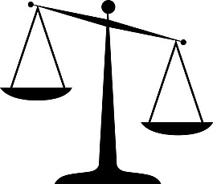
Toward an Interpretable Knowledge Tracing Model
Interpretability
Performance
Flexibility
Literature Review
Haoting Chen
u7227871@anu.edu.au

Slide 2
Contents
Knowledge Tracing: Problem Definition
Knowledge Tracing Process: A High Level View
Typical Types of Knowledge Tracing Models
  Graph Neural Network (GNN)
  Key-Value Memory Network (KVMN)
  Recurrent Neural Network (RNN)
  Transformers
Research Gaps
Research Question
Research Plan
Bonus Slides
(pg. 4 )
(pg. 5 )
(pg. 8 )
(pg.11)
(pg.14)
(pg.17)
(pg.20)
(pg.24)
(pg.25)
(pg.30)

Slide 3
Knowledge Tracing (KT)
“[Using] machines to track the knowledge of students and tailor their learning experience”
---- (Abdelrahman 2022)

Slide 4
Problem Definition
Given:
  [(q1, right), (q8, wrong), (q6, right), (q1, wrong)…]
  (q6, ?)
Output
  right/wrong
Given the student historical performance, predict the student’s performance on a query question.
The historical performance can be represented as a list of (Question ID, Result) Interactions, sorted by time.
Usually, the query question have been done by the student before, i.e., appearing in the historical performance list.

Slide 5
Problem Definition (More Formal)
Given
😯 Expensive 💲
Manually Annotated
Question ID | Timestamp | Question Text | Duration | Knowledge Components | ... | Result
q1 | 1 Sep | What is 55 + 63? | 5s | [Addition, … ] | ... | right
q8 | 1 Sep | What is 64 x 64? | 20s | [Multiplication, ...] | ... | wrong
q6 | 2 Sep | What is 12 / 3? | 1s | [Division, ...] | ... | right
q1 | 1 Oct | What is 55 + 63? | 10s | [Addition, ...] | ... | wrong
Output
Probability (right | q6, Additional Features, Historical Interactions)
Datasets usually provides more than just (Question ID, Result) pairs. However, having ordered (Question, Result) pairs is sufficient to do knowledge tracing. We will mainly discuss the case when only the (Question, Result) pairs are available.

Slide 6
A High-Level View of Knowledge Tracing
Many knowledge tracing models are essentially doing two things logically, even though the ways they do are different.
Modelling the latent Knowledge Components (KCs) and their relationship in the questions.
Modelling the growth (learning) and decay (forgetting) of the Knowledge Components of a student over time.
Why does it work?
Given a past attempt, (Question ID, Result), the model first transforms the Question into a combination of some Knowledge Components, and update the Mastery of the related Knowledge Components based on the Result.
Given a query Question, the model transforms it into a combination of some Knowledge Components. Based on the Mastery of the related Knowledge Components updated early, we can then predict if the student can answer it right.
Notes:
Why should we bother KC? Imagine you are a teacher. You usually care about how well you have mastered the knowledge that the question tries to test. Not the question itself.
Back to the previous slide. If KCs are provided in the dataset, that is ideal. However, it is usually the job of the model to figure what are the KCs hidden in the question.

Slide 7
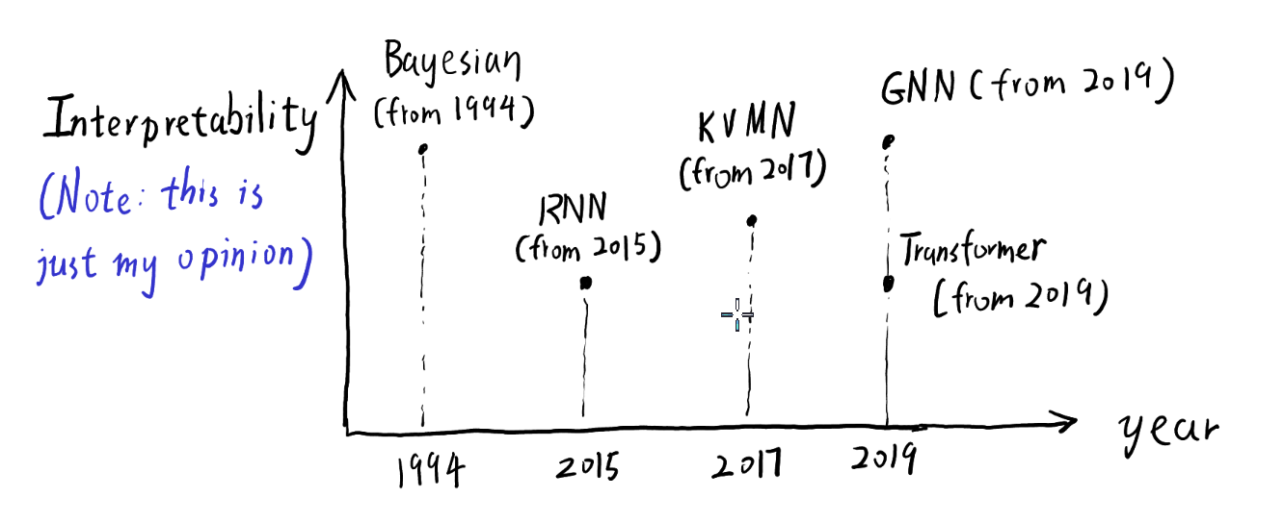
Typical Knowledge Tracing Model Architectures
Let’s explore them in reverse order 💪
Bayesian: Bayesian Belief Network
RNN: Recurrent Neural Network
KVMN: Key-Value Memory Network
GNN: Graph Neural Network
Transformer: Transformer
Note: the year represents when the specific model architecture was first used for Knowledge Tracing, not the invention of the model architecture itself.

Slide 8
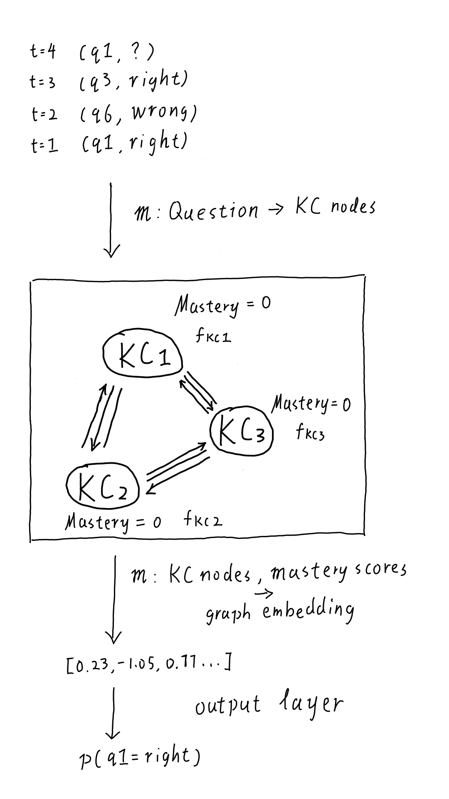
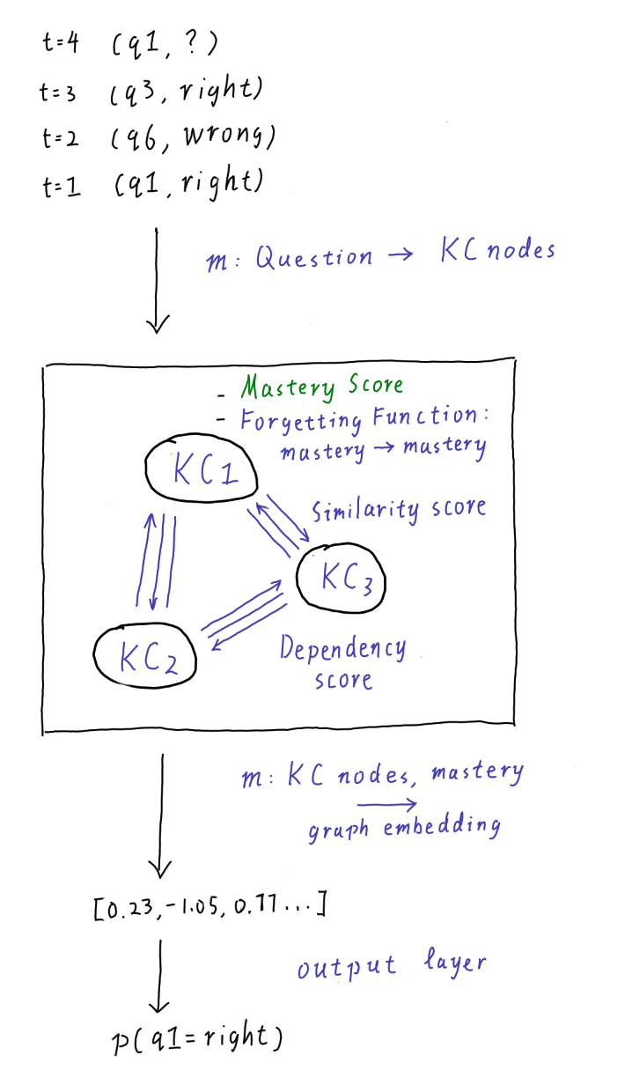
Graph Neural Network
Static/global parameters.
  Learned during training.
  Fixed at inference.
Dynamic/online parameters.
  Updated during inference.
  Specific to each student / [(Question, ID)]
Note: the RHS graph does not tie to any specific graph-based knowledge tracing models (GKT), but it is adapted from a couple of GKT models, especially Abdelrahman et al.’s Deep Graph Memory Network (DGMN), to give a simple and intuitive view of how GKT works in general. Here are some simplifications made:
Mastery of each node is usually represented as a vector instead of just a scalar.
The mappings between questions and KCs are not binary. A question can map to all KCs with some weights
Ghodai Abdelrahman and Qing Wang. 2022. Deep graph memory networks for forgetting-robust knowledge tracing.
TKDE (2022)
Notes:
Up-de-ra-ha-men
Talk about how to train as well

Slide 9
Graph Neural Network (Analysis)
🤔 How does it model KCs?
Explicitly through nodes.
🤔 How does it model KC-KC relations?
Explicitly through edges.
🤔 How does it model the learning of KCs?
Explicitly through node updates + message passing
🤔 How does it model the forgetting of KCs?
Explicitly through Forgetting Functions
🤔 How does it model the student’s knowledge state?
Explicitly through a graph.

Slide 10
Model Architectures Visited So Far
Architecture | KCs | KC-KC Relations | Leaning of KCs | Time-Based Forgetting of KC | Student’s Knowledge State
Graph Neural Network | Explicit as Nodes | Explicit as Edges | Explicit via node update + message passing | Explicit via Forgetting Functions | Explicit as a Graph
Note: For clarity, we would like say the model has explicitly modelled a hidden knowledge tracing component (e.g., KCs) or a process (e.g., forgetting), if there exists clearly identifiable variables or functions dedicatedly representing the component or process. Otherwise, the model behaves implicitly.
Note: Even though GNN has explicitly modelled KCs as nodes, it doesn’t mean the KC nodes themselves are explicit and interpretable. In GNN, the nodes are usually some vector embeddings, representing the mix of some real world KCs, like Addition and Subtraction.
Notes:
Note that explicit is to some extent. The KC nodes itself may not be interpretable

Slide 11
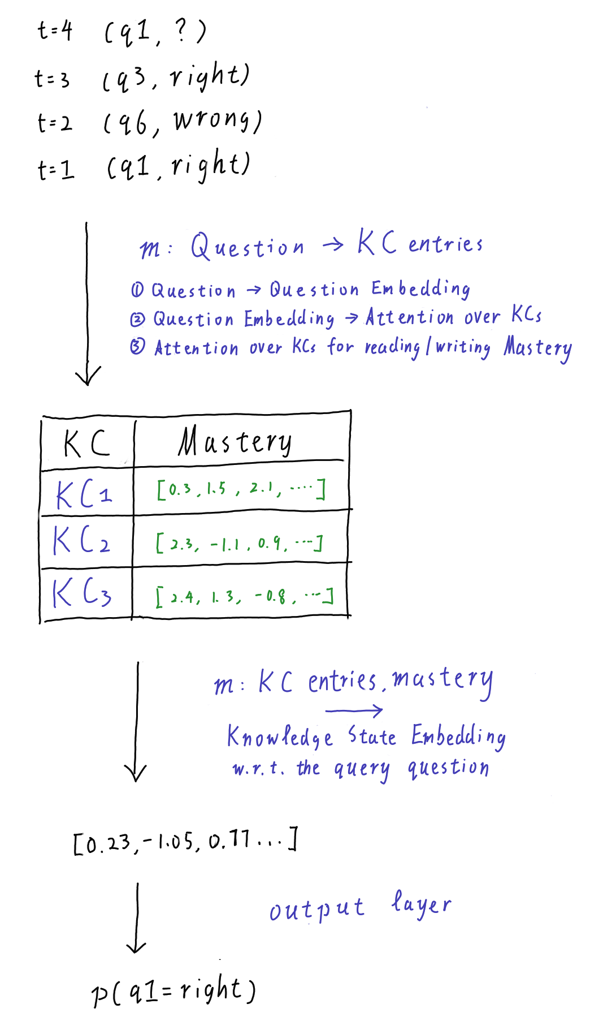
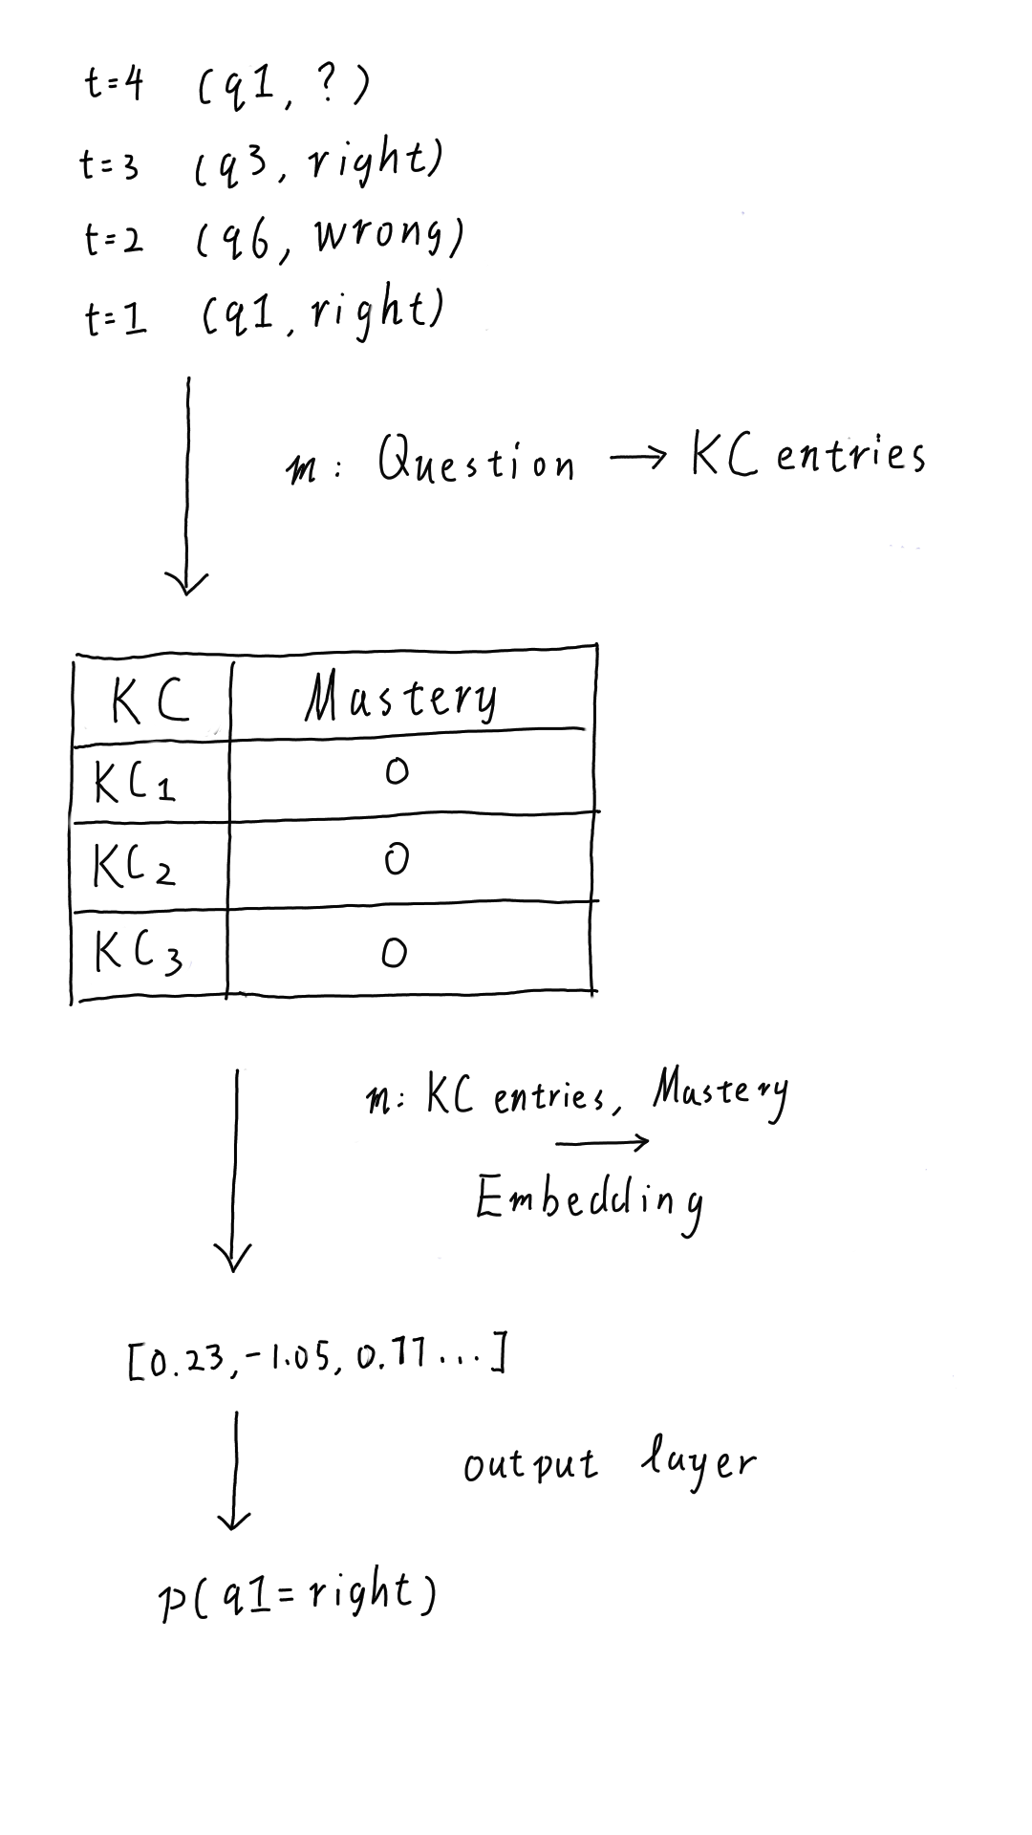
Key-Value Memory
Network
Note that the RHS graph is an simplified view of a Key-Value Memory Network.
Mastery of each node is usually represented as a vector embedding instead of just a scalar.
The KC keys, .e.g, KC1 and KC2, are also some vector embeddings.
Relevant Models:
Jiani Zhang, Xingjian Shi, Irwin King, and Dit-Yan Yeung. 2017. Dynamic key-value memory networks for knowledge tracing. In WWW. 765–774.
Ghodai Abdelrahman and Qing Wang. 2019. Knowledge tracing with sequential key-value memory networks. In SIGIR. 175–184.

Slide 12
Key-Value Memory Network (Analysis)
🤔 How does it model KCs?
Explicitly through keys.
🤔 How does it model KC-KC relations?
❌ The KC-KC relations are generally missing.
🤔 How does it model the learning of KCs?
Explicitly through erase-add update for mastery values
🤔 How does it model the forgetting of KCs?
❌ No explicit time-based forgetting
🤔 How does it model the student’s knowledge state?
Explicitly through a table of keys and values.

Slide 13
Model Architectures Visited So Far
Architecture | KCs | KC-KC Relations | Leaning of KCs | Time-Based Forgetting of KCs | Student’s Knowledge State
Graph Neural Network | Explicit as Nodes | Explicit as Edges | Explicit via node update + message passing | Explicit via Forgetting Functions | Explicit as a Graph
Key-Value Memory Network | Explicit as Keys | --------- | Explicit via erase-add update | --------- | Explicit as a Key-Value Table
Notes:
Note that explicit is to some extent. The KC nodes itself may not be interpretable

Slide 14
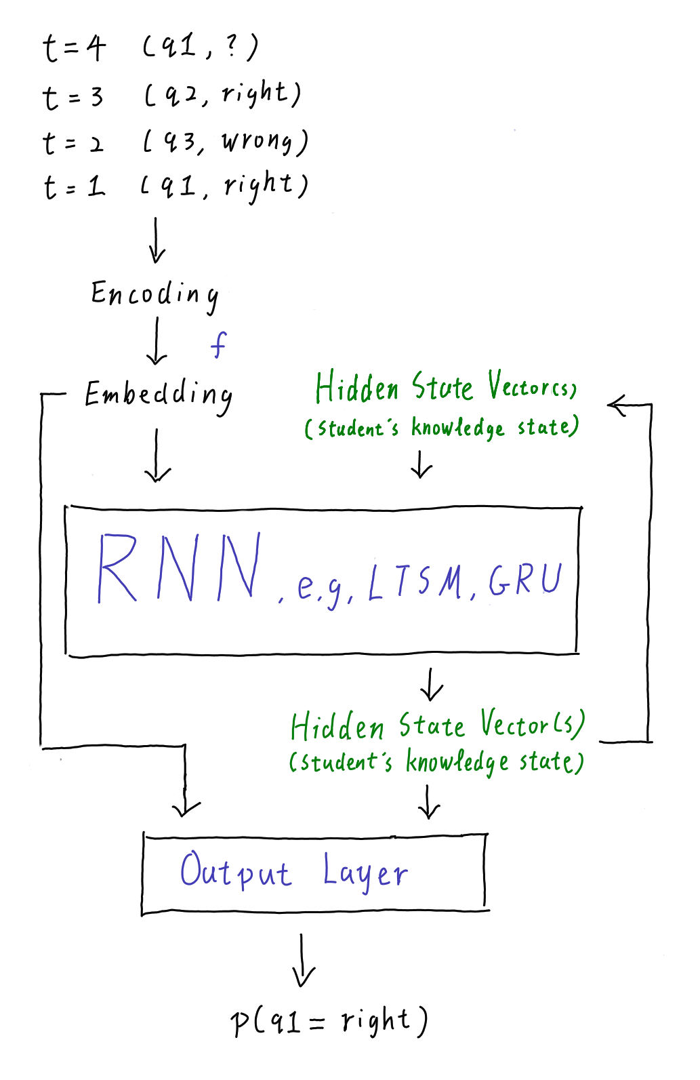
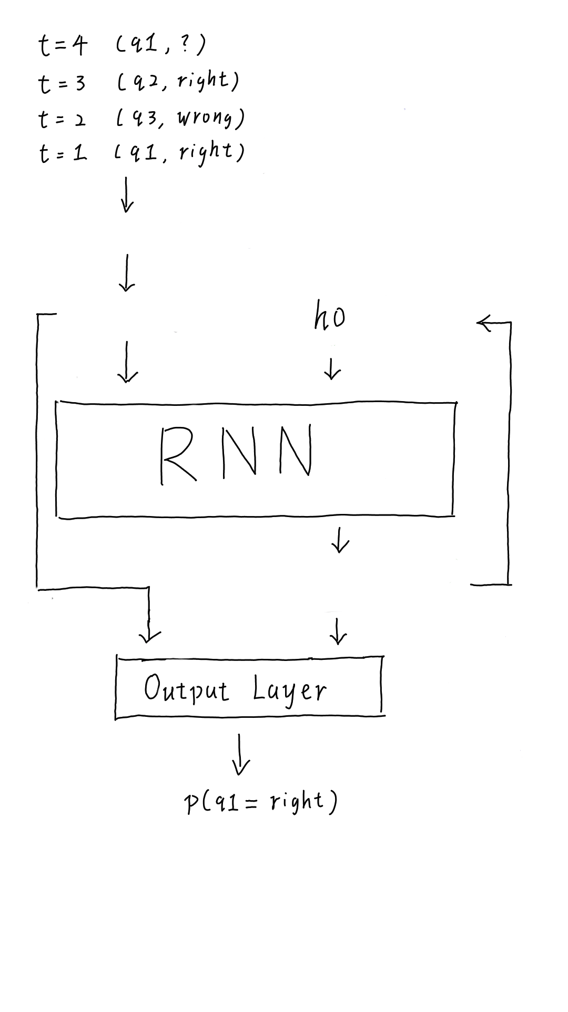
Recurrent Neural Network
Static/global parameters.
  Learned during training.
  Fixed at inference.
Dynamic/online parameters.
  Updated during inference.
  Specific to each student
  / [(Question, ID)]
Relevant Models:
Chris Piech, Jonathan Bassen, Jonathan Huang, Surya Ganguli, Mehran Sahami, Leonidas J. Guibas, and Jascha Sohl-
Dickstein. 2015. Deep knowledge tracing. In NeurIPS. 505–513.
Xiaolu Xiong, Siyuan Zhao, Eric Van Inwegen, and Joseph Beck. 2016. Going deeper with deep knowledge tracing.
In EDM. 545–550.
Chun-Kit Yeung and Dit-Yan Yeung. 2018. Addressing two problems in deep knowledge tracing via prediction-
consistent regularization. In L@S. 1–10
Notes:
Up-de-ra-ha-men

Slide 15
Recurrent Neural Network (Analysis)
🤔 How does it model KCs?
Implicitly through Question Embeddings.
Why implicit? We cannot identify individual KCs in the model.
Why modelled? Questions with similar KCs may lead to similar embeddings.
🤔 How does it model KC-KC relations?
Implicitly through Recurrent Weights
🤔 How does it model the learning of KCs?
Implicitly through the Input & Update Gates in the RNN
🤔 How does it model the forgetting of KCs?
Implicitly through the Forget Gate in the RNN
🤔 How does it model the student’s knowledge state?
Explicitly through a hidden state vector(s)
Notes:
🤔 How does it model KC-KC relations?
Implicitly through Recurrent Weights
Why implicit? There’s no explicit graph or adjacency matrix connecting skills.
Why modelled? The recurrent update ht = f(Wh ht − 1 + Wx xt t), allows every dimension in h t-1 to influence every other dimension in ht. As a result, if learning one skill helps or hinders another, the RNN can learn these cross-dependencies through its shared recurrent weights.
🤔 How does it model the learning of KCs?
Implicitly through the Input & Update Gates in RNN
Why implicit? No explicit learning function.
Why modelled? When a new interaction (qt,rt) arrives, the input gate and update operation of the RNN decide how much new information to add to the hidden state
🤔 How does it model the forgetting of KCs?
Implicitly through the Forget Gate in RNN
Why implicit? No dedicated forgetting functions
Why modelled? The forget gate ft=σ(Wfxt+Ufht−1+bf) controls how much of the previous memory ct−1 to retain
🤔 How does it model the student’s knowledge state?
Explicitly through a hidden state vector(s)

Slide 16
Model Architectures Visited So Far
Architecture | KCs | KC-KC Relations | Leaning of KCs | Time-Based Forgetting of KCs | Student’s Knowledge State
Graph Neural Network | Explicit as Nodes | Explicit as Edges | Explicit via node update + message passing | Explicit via Forgetting Functions | Explicit as a Graph
Key-Value Memory Network | Explicit as Keys | --------- | Explicit via erase-add update | --------- | Explicit as a Key-Value Table
Recurrent Neural Network | Implicit through Question Embedding | Implicit through Recurrent Weights | Implicit through the Input & Update Gates | Implicit through the Forget Gate | Explicit as a hidden state vector(s)
Notes:
Note that explicit is to some extent. The KC nodes itself may not be interpretable

Slide 17
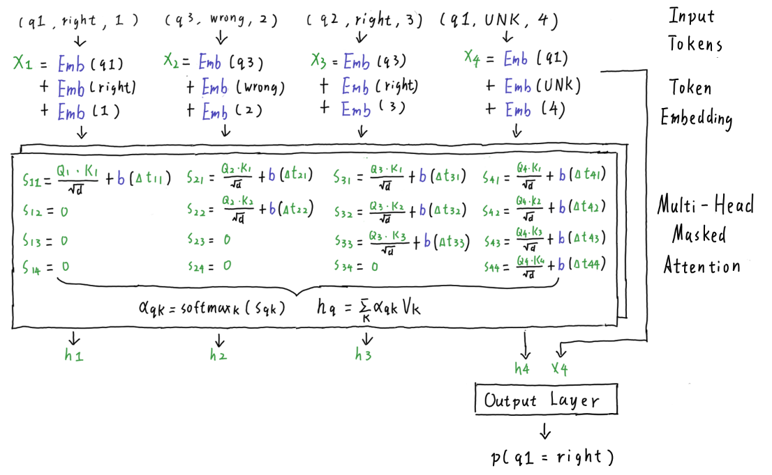
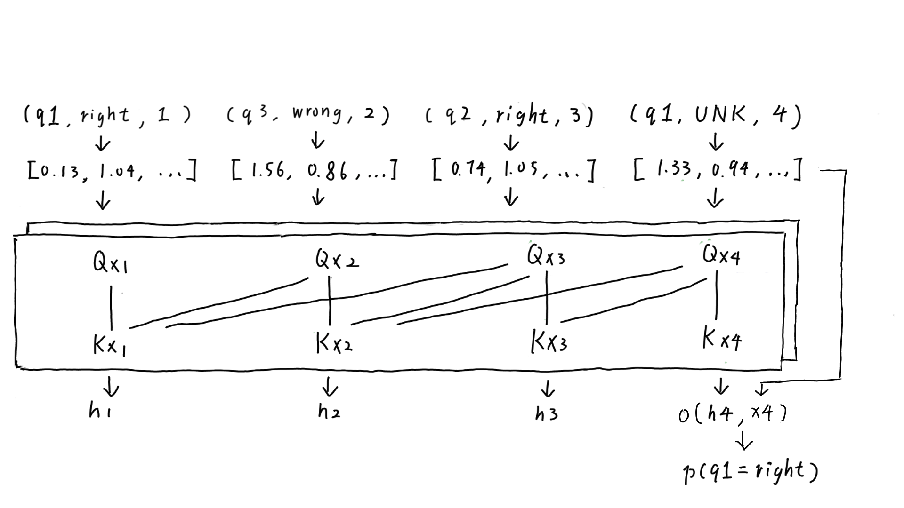
s: similarity score between two embeddings
b(Δt): forgetting function
α: attention weights
h: query-conditioned student’s knowledge state
h4: the student’s knowledge state for answering q1 at t = 4, given their history [(q1,right) (q3,wrong) (q2,right)]
Transformer
Encoder Only (As Above) -- Aritra Ghosh, Neil Heffernan, and Andrew S. Lan. 2020. Context-aware attentive knowledge tracing. In SIGKDD.
2330–2339.
Encoder-Decoder (Not Discussed Here) -- Dongmin Shin, Yugeun Shim, Hangyeol Yu, Seewoo Lee, Byungsoo Kim, and Youngduck Choi. 2021. SAINT+: Inte-
grating temporal features for EdNet correctness prediction. In LAK. 490–496.

Slide 18
Transformer (Analysis)
🤔 How does it model KCs?
Implicitly through embeddings
🤔 How does it model KC-KC relations?
Implicitly through attention weights
Historical questions with hidden KCs relevant to the KCs in the query question may be attended more.
🤔 How does it model the learning of KCs?
Implicitly through attention mechanism.
How much information each past interaction contributes to the next prediction?
🤔 How does it model the forgetting of KCs?
Explicitly through forgetting functions
🤔 How does it model the student’s knowledge state?
The student’s global knowledge state is implicit
The query-conditioned knowledge state is
modelled explicitly as a vector embedding.

Slide 19
Model Architectures Visited So Far
Architecture | KCs | KC-KC Relations | Leaning of KCs | Time-Based Forgetting of KCs | Student’s Knowledge State
Graph Neural Network | Explicit as Nodes | Explicit as Edges | Explicit via node update + message passing | Explicit via Forgetting Functions | Explicit as a Graph
Key-Value Memory Network | Explicit as Keys | --------- | Explicit via erase-add update | --------- | Explicit as a Key-Value Table
Recurrent Neural Network | Implicit as Question Embedding | Implicit as Recurrent Weights | Implicit via the Input & Update Gates | Implicit via the Forget Gate | Explicit as a hidden state vector(s)
Transformer | Implicit as Embeddings | Implicit as attention weights | Implicit via attention mechanism | Explicitly through forgetting functions | Full knowledge state is implicit
Notes:
Note that explicit is to some extent. The KC nodes itself may not be interpretable

Slide 20
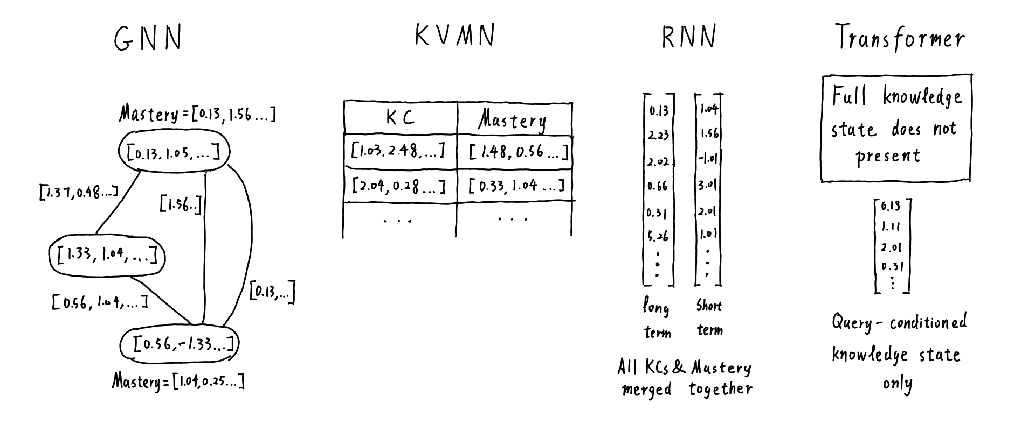
Which knowledge states are more interpretable?
Notes:
Now we got to the most interesting part
I think it is GNN

Slide 21
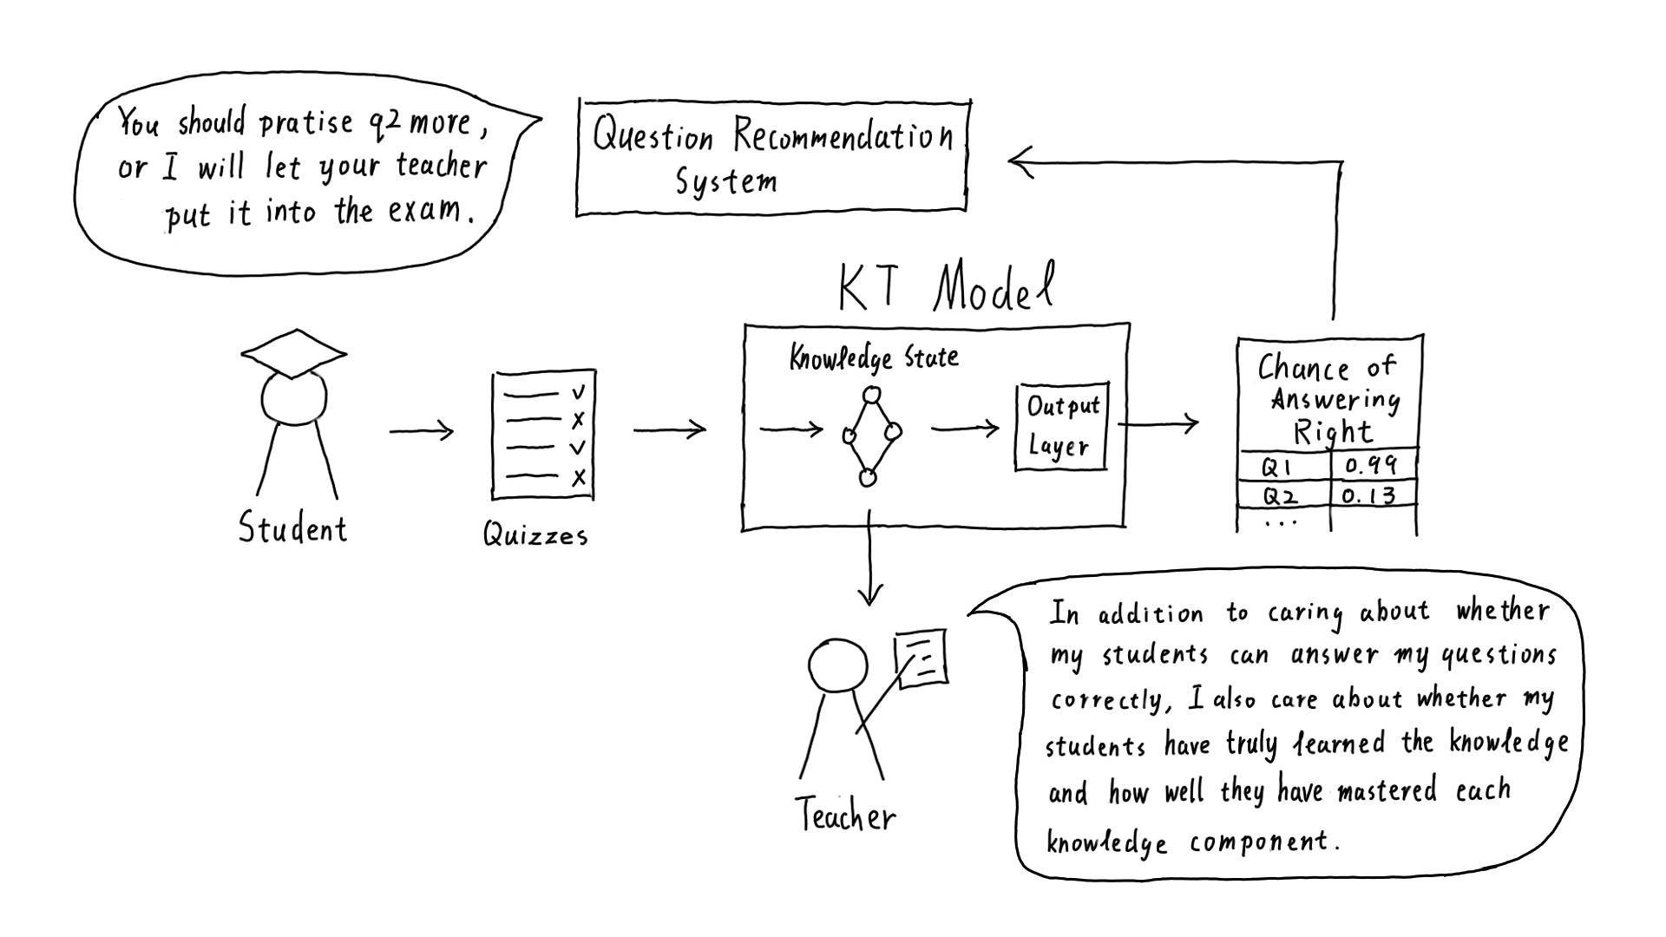
Why should we bother interpretable knowledge states?

Slide 22
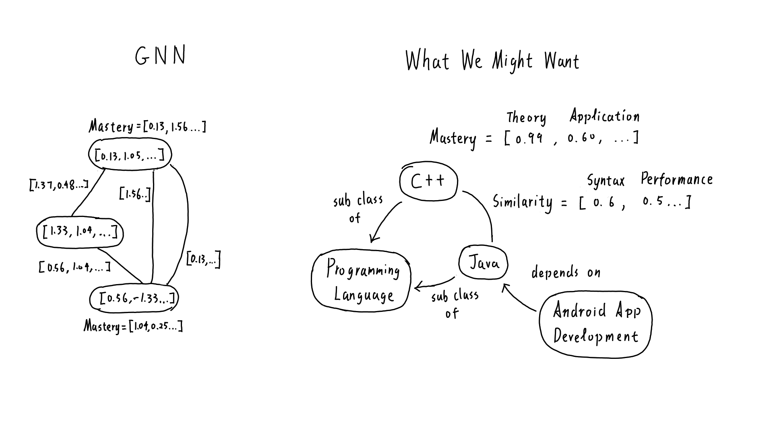
Is it interpretable enough?
It is reasonable that the nodes in the KC graph created by current GNN are implicit, instead of some real-world KCs. This is because the model have not yet access to the text of the questions. What if the model can now access to the question text. Can we map the implicit KC node embedding back to some real-world KCs?

Slide 23
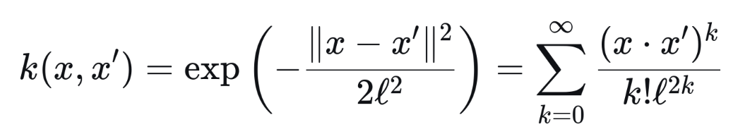
Challenges of making things explicit and interpretable
Explicitness vs. Flexibility
Consider a function σ(q) which can convert an interaction into its latent knowledge state representation.
What does GNN/RNN do conceptually?
Transforms both the student history and the query question into its latent knowledge state representation. h = σ(student’s history) and h_query = σ(query question). Makes prediction based on how well h aligns with h_query, e.g., (h ⋅ h_query).
Kernel Trick
(h ⋅ h_query) = σ(student’s history) ⋅ σ(query question) = K(student’s history, query question), for some kernel function K. We don’t actually need to transform them into latent knowledge state. We can learn a kernel function K and compare the student’s history and query question directly. This is basically how transformers do KT?
Benefits of being implicit
Without explicitly representing the knowledge state, the knowledge state can then be arbitrarily complex. A classical example in Machine Learning: RBF kernel (equivalent to the dot product of two latent variables with infinite number of dimensions! )

Slide 24
Research Question
How can we make Knowledge Tracing models, especially Graph-based KT, more explicit and interpretable — enabling human teachers to understand students’ knowledge states — without severely sacrificing flexibility?

Slide 25
Research Plan:
Two Stages/Directions
Stage 1: (Build an interpretable KT model right away, by scarifying some flexibility)
Use a language model to generate human-readable KCs to initialise and train a Graph-KT model.
Stage 2: (Make a flexible KT model interpretable as well)
Given a trained Graph-KT model, map its implicit KC nodes embedding to some meaningful and human-interpretable KCs / text.

Slide 26
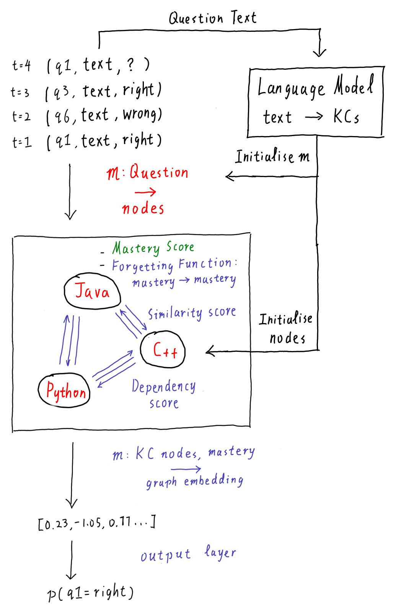
Stage 1: LLM for GNN Initialisation
Given the student history [(Question ID, Question Text, Result)]
Train a language model to generate all possible real-world KCs from the question text.
Use them to initialise the nodes of a Graph-KT Models.
Fix the nodes as well as the mapping between questions and KC nodes during training.
The trained KT model should inherently contain explicit and interpretable KCs
Limitation:
We can no longer model complex KCs and their relations, e.g., hierarchical KCs, if we does not explicitly do so, since they are fixed during training.
Explicitness ⬆️ Interpretability ⬆️ Flexibility ⬇️
Dynamically Initialised.
Fixed during Training.
Static/global parameters
Learned during training
Fixed at inference
Dynamic/online parameters
Update during inference

Slide 27
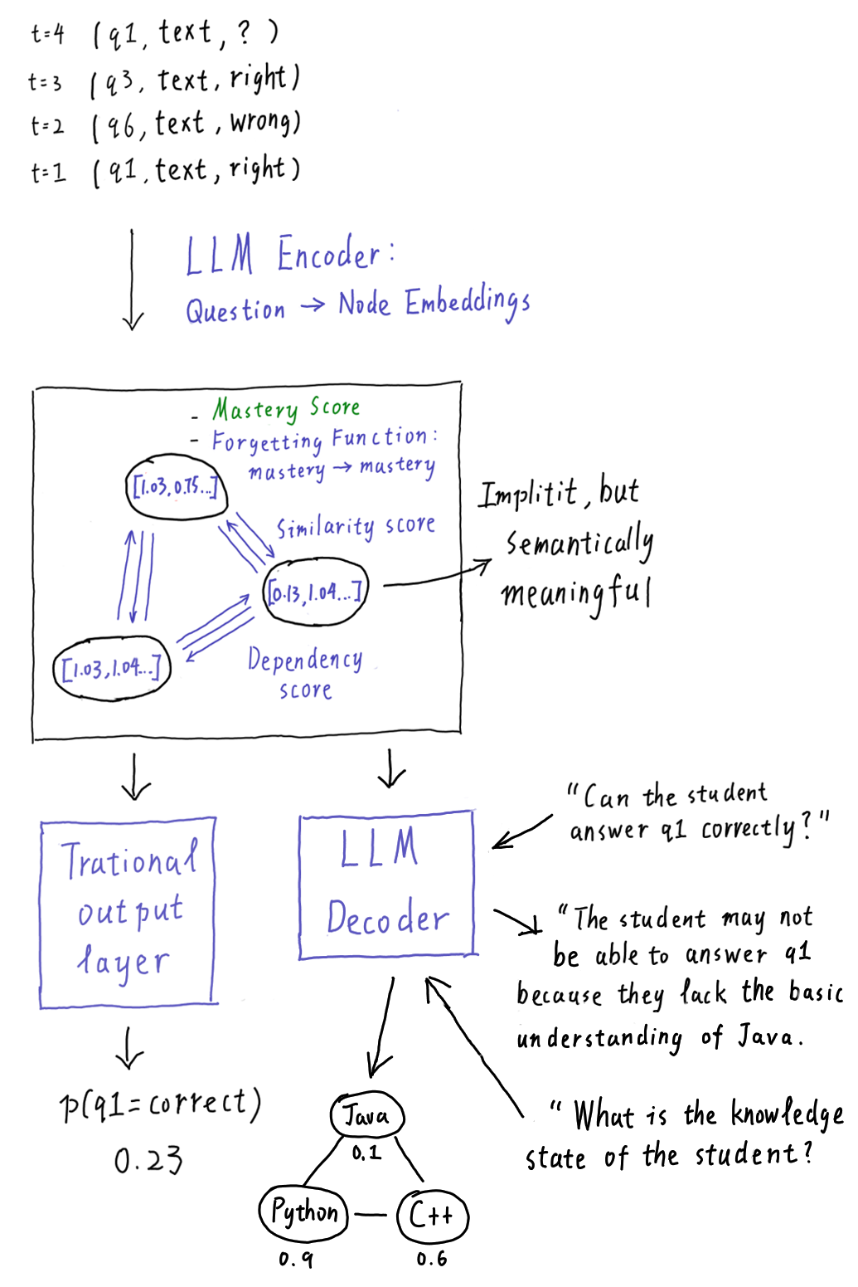
Stage 2: LLM-GNN Fusion
Use a Large Language Model (LLM) Encoder to do the mapping from (question ID, text, result) to node embedding in the graph of GNN.
The nodes in GNN remains implicit, but they are now semantically meaningful
Use a LLM decoder to decode the implicit knowledge state into natural language.
Interpretability ⬆️ Flexibility ⬆️
Implicitness Remains

Slide 28
Our Goals
Interpretability
Performance
Flexibility
Performance
Flexibility
Interpretability
Hard Work

Slide 29
Thank you for your attention
Bonus Slides:
Bayesian Network: a type of KT model architecture (also the oldest KT model architecture) that is explicit, interpretable, but not flexible and has low performance. (pg. 29)
Dataset Challenge: many KT datasets do not provide the text of the questions, which is essential for training LLMs. (pg. 32)

Slide 30
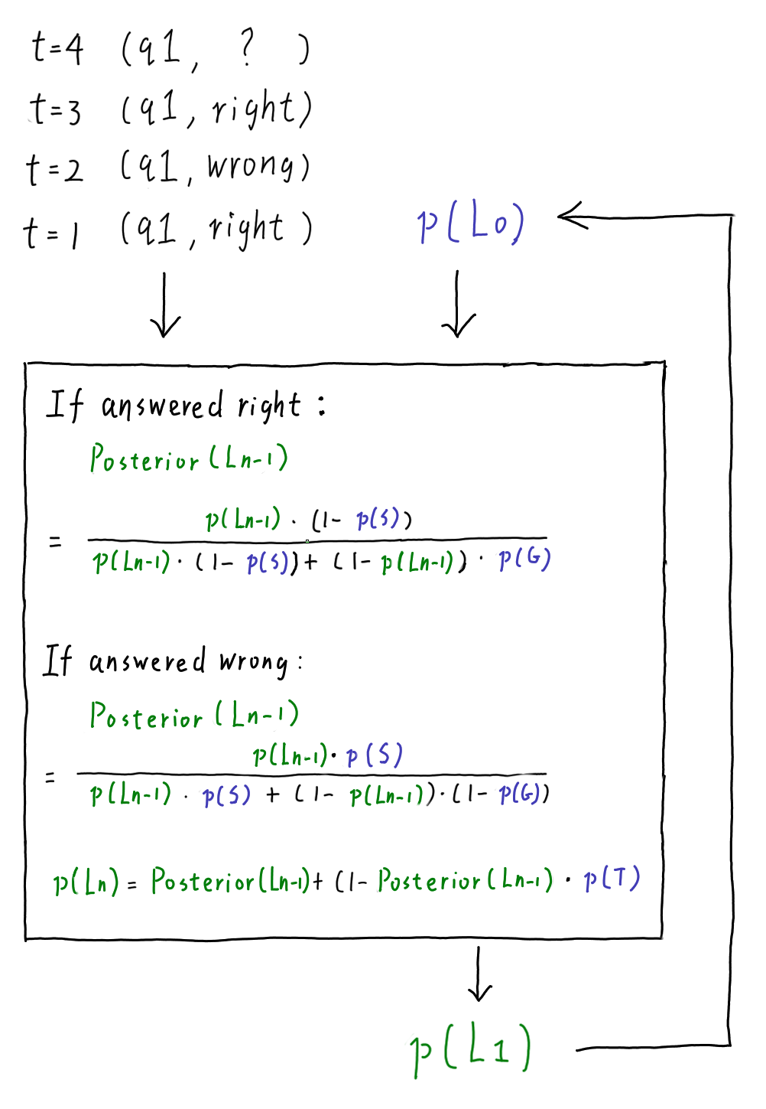
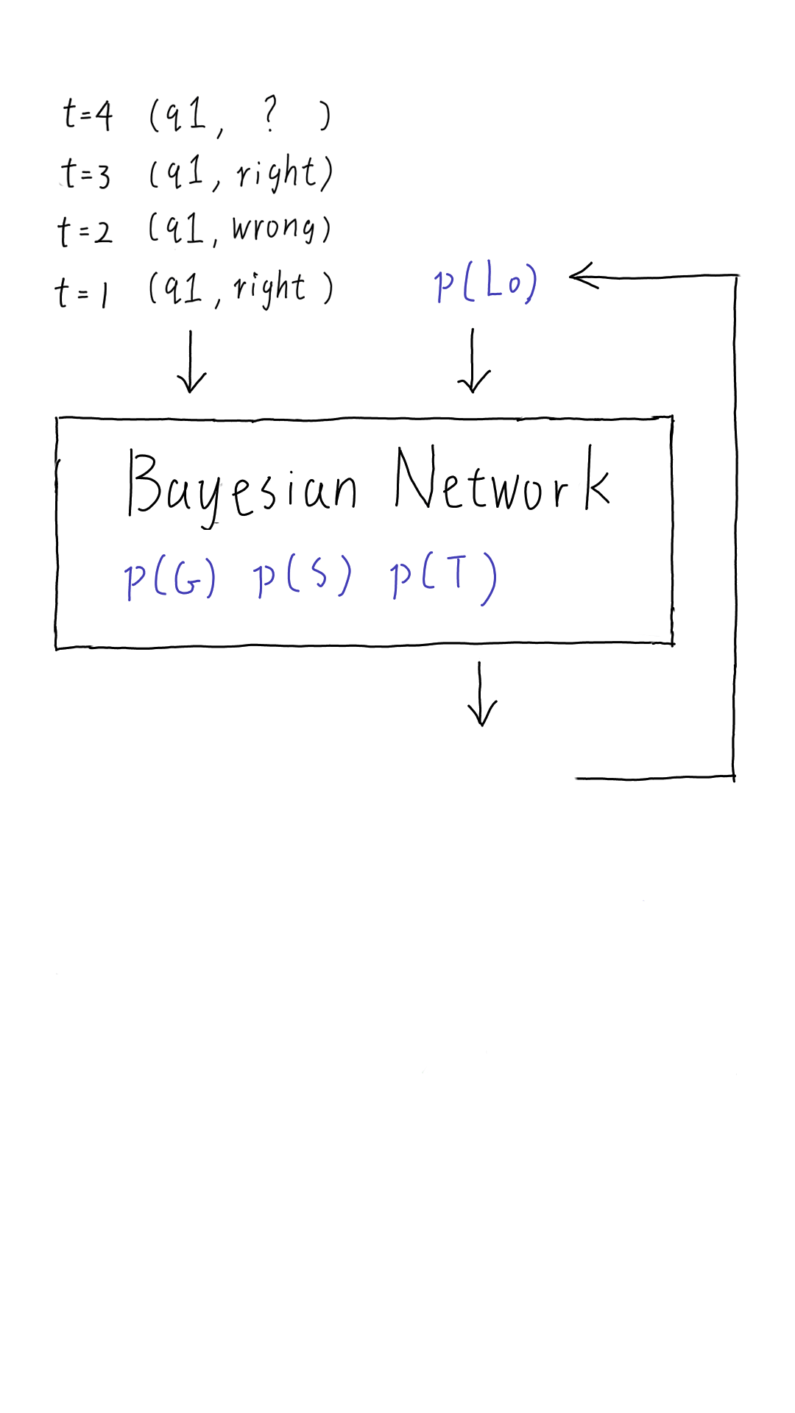
Bayesian Network
The model can only trace the student interactions of a single question. Hence, there is only one latent KC, i.e., the KC for answering the question.
The student’s latent knowledge state at t = n, p(Ln), also represents the probability the student can correctly answer the question.
The RHS graph is already the full model the original Bayesian BT (BKT), not a conceptual graph.
The mastery is binary.
For multiple questions, we build a separate BKT model for each.
Static Parameters.
p(G): The probability of guessing right, i.e., the probability of answering the question right even in an unlearned state.
p(S): The probability of slipping, i.e., the probability of answering the question wrong in a learned state.
p(T): The probability of transiting from a unlearned state to a learned state between t = n and t = n+1.
p(L0): The probability that the student have mastered the KC initially.
Online parameters.
p(Ln): The probability that the student have masted the KC at t=n. Also the probability that the student can answer the quesiton at t=n.
Albert T. Corbett and John R. Anderson. 1994. Knowledge tracing: Modeling the acquisition of procedural knowledge.
UMUAI 4 (1994), 253–278.

Slide 31
Bayesian Network (Analysis)
🤔 How does it model KCs?
❌ Does not model. It is assumed that one question corresponds to one KC only.
🤔 How does it model KC-KC relations?
❌ Does not model.
🤔 How does it model the learning of KCs?
Explicitly through a single probability value, p(T)
🤔 How does it model the forgetting of KCs?
❌ Does not model.
🤔 How does it model the student’s knowledge state?
Explicitly through a single probability value, p(Ln)

Slide 32
Model Architectures Visited So Far
Architecture | KCs | KC-KC Relations | Leaning of KCs | Time-Based Forgetting of KCs | Student’s Knowledge State
Graph Neural Network | Explicit as Nodes | Explicit as Edges | Explicit via node update + message passing | Explicit via Forgetting Functions | Explicit as a Graph
Key-Value Memory Network | Explicit as Keys | --------- | Explicit via erase-add update | --------- | Explicit as a Key-Value Table
Recurrent Neural Network | Implicit as Question Embedding | Implicit as Recurrent Weights | Implicit via the Input & Update Gates | Implicit via the Forget Gate | Explicit as a hidden state vector(s)
Transformer | Implicit as Embeddings | Implicit as attention weights | Implicit via attention mechanism | Explicitly through forgetting functions | Full knowledge state is implicit
Bayesian Network | --------- | --------- | Explicitly as a single probability value, p(T) | --------- | Explicitly as a single probability value, p(Ln)
Notes:
Note that explicit is to some extent. The KC nodes itself may not be interpretable

Slide 33
Dataset Challenge
Both stage 1 and stage 2’s proposed models require the text of the questions to be available for training LLMs. However, most public KT dataset does not provide the text of the questions other than their IDs. This is probably because the questions are intellectual property of the educational institutes which provide the datasets. Publishing the original test questions along with the KT dataset to the public may affect their commercial interests.
In contrast, many datasets provides manually annotated KCs and KC-Question mappings by experts. However, during the deployment of a KT model, requiring manually annotated KCs by teachers is not realistic and automatic. In nowadays deep learning, it is usually the job of the model to find out the latent KCs. However, the question text is generally available automatically. Assume that the model is deployed privately in an institute. The model should be able to access the private question text. Because all (Question ID, Question Text, Result) can be obtained directly from teachers without further labelling, the training of KT models is self-supervised, which enables the use of large-scale data in training.

